Slide 1

EMOTION RECOGNITION UNDER DECEPTION IN MENTAL HEALTH
Integrating Facial, Audio, and Physiological Data with Advanced Machine Learning Techniques
1

Slide 2
Introduction
Project Focus
Key Components
Multimodal Integration
This project focuses on the development and analysis of a system designed for real-time emotion detection and deception analysis.
The system integrates multimodal inputs such as facial video, audio signals, and optional physiological data to enhance accuracy.
The system includes preprocessing, feature extraction, and classification techniques tailored for deception detection.
Facial video, audio signals, and physiological data are combined to improve the system's accuracy.
This integration ensures a comprehensive analysis of emotional and deceptive cues.
2

Slide 3
Problem Statement
Literature Review 1 –
MER Using ConVAT with Multihead Attention Mechanism
IEEE Access, January 2025
How can we design a model that effectively captures the short- lived temporal dynamics of micro-expressions while also generalizing well across different subjects and datasets, despite the scarcity and imbalance of training data?
Methodology
ConVAT
LOSO
Dataset
SAMM, CASME II, SMIC
Result
Achieving impressive performance with 98.73% accuracy on SAMM dataset
97.95% on SMIC dataset
97.65% on CASME II
Research Context
The study is published in a specific year and by a particular publisher.
3

Slide 4
Literature Review 1 - Limitations
Dataset Limitations
Environmental Noise and Lighting
The dataset size and diversity are limited, potentially affecting generalizability.
This constraint may hinder the model's ability to perform well across different populations.
The model's performance under varied environmental noise and lighting conditions remains untested.
Such untested conditions could significantly affect the robustness of the model.
Real-Time Processing Challenges
Real-time processing constraints are not fully addressed, impacting practical deployment.
This limitation raises concerns about the model's usability in dynamic, real-world scenarios.
It relies solely on facial features ignoring other cues such as tone, physiological signals
4

Slide 5
Literature Review 1 - Future Scope
Expanding Datasets
Optimizing Algorithms
Integrating Physiological Metrics
Robust Preprocessing Techniques
Future research aims to broaden datasets to encompass diverse populations.
This includes real-world scenarios to ensure comprehensive applicability.
Efforts are directed towards enhancing real-time inference capabilities.
This involves the development of optimized algorithms for better performance.
Research focuses on incorporating additional physiological metrics.
This aims to achieve richer and more detailed data representation.
Developing preprocessing methods to address environmental variability is a priority.
Such techniques are crucial for ensuring data reliability and accuracy.
5
Multimodal Real-Time Emotion and Deception Detection System

Slide 6
Literature Review 2 – Survey on Detection and Impacts of Deepfakes IEEE, December 2023
Problem Statement
Methodology
Dataset
Result
Fragmented research focus
Lack of holistic evaluation
Inadequate Detection Solutions.
System Literature review framework
Database search & Paper selection
Screening & Filtering Criteria
Data Extraction & Synthesis
Organisation of the review
Used reference datasets(DFDC, ASV spoof)
Did not use specific dataset
Roadmap for the future
Provided 1st integrated survey of visual, audio, and text deepfakes
Next generation of solutions must be holistic, multimodal.
.
6
Multimodal Real-Time Emotion and Deception Detection System

Slide 7

Literature Review 2 - Limitations
?
No original experimental validation
Dependence on existing literature
Limited guidance for practical implementation
.
7

Slide 8
Literature Review 3- Deception Detection Model using Integrated LLM with Emotion Features
Springer, September 2025
Problem Statement
Methodology
Dataset
Result
Reliance on intuition and experience of human interrogators, makes it prone to errors.
Need for accurate, efficient method for emotional cues.
Data Collection
Feature Extraction
Modeling
Evaluation
Used special dataset of interrogation texts, enriched with emotional, facial and action gestures.
LieXBerta model achieved 87.5% accuracy(6.5% higher)
Runtime was reduced by 42%
Fast, efficient
8

Slide 9
Dataset Constraints
Dataset size is often small due to the complexity of data acquisition.
This limits the robustness of findings.
Literature Review 3 - Limitations
Experimental Limitations
Real-world applicability is constrained by controlled experimental settings.
Such settings may not accurately reflect real-world scenarios.
9

Slide 10
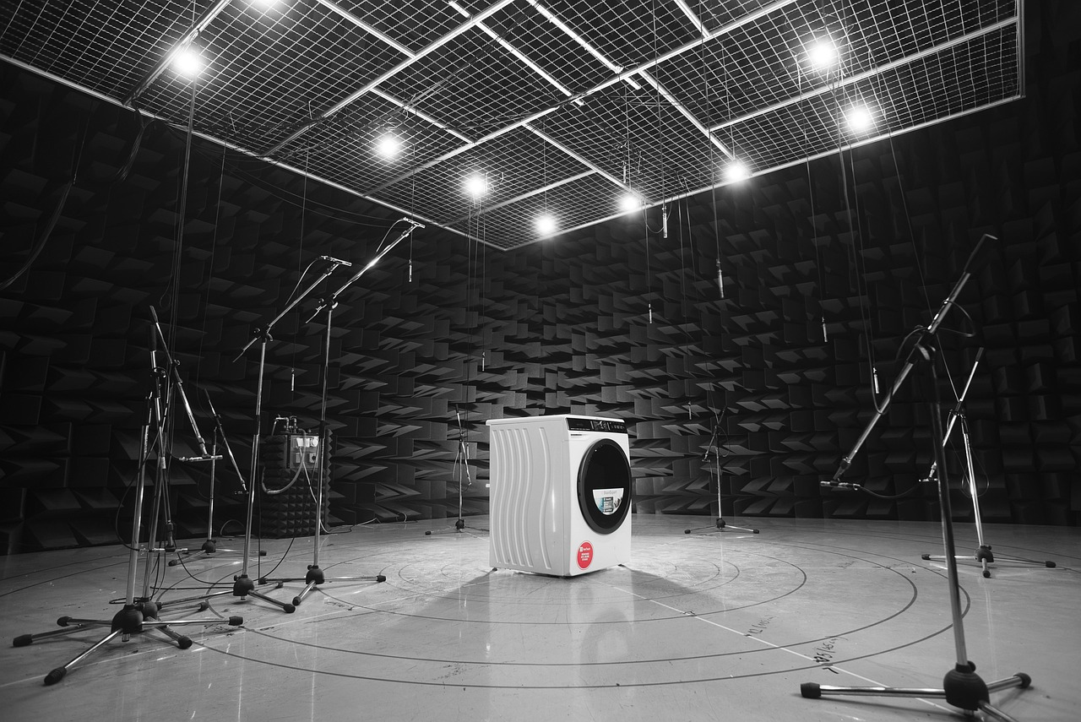
Literature Review 3 - Future Scope
Enhance Detection
Expanding Deception Scenario Datasets
Incorporate audio features such as tone, pitch and speech patterns
There is a need to expand datasets with naturalistic deception scenarios.
This will provide a broader foundation for studying deception in diverse contexts.
10

Slide 11
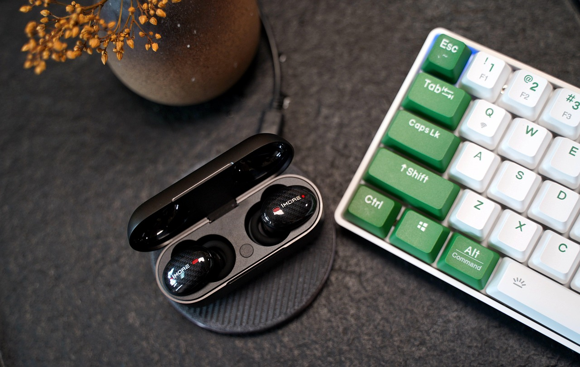
Literature Review 4- Multi-class Facial Emotion Expression Identification Using DL based feature extraction
Springer February, 2024
Problem Statement
Methodology
Dataset
Result
Recognizing multiple facial emotions is challenging
Need for a robust system that can efficiently process, extract and classify emotions
Data Pre Processing
Feature Extraction
Classification
Performance Evaluation
FER 2013
EMOTIC
95.82% accuracy
95.81% F1 score
95% recall
12
Multimodal Real-Time Emotion and Deception Detection System

Slide 12
Literature Review 4 - Limitations
Dataset Constraints
Model Complexity
.
Real-time processing demands are not fully addressed.
This gap could hinder the practical implementation of the techniques.
Limits the model’s generalizability
12

Slide 13
Literature Review 4 - Future Scope
Incorporation of Temporal Dynamics
Exploration of Lightweight models
Improve modal’s ability to capture dynamic facial expression
Deployment of FER systems on Mobile, making them more accessible
13

Slide 14

Problem Statement
Reliability of current MER systems(which use multiple signals) on contact -based sensors can be impractical for real world applications.
Need for contactless MER techniques (reliable, addresses ethical & privacy concerns)
Literature Review 5 – Exploring Contactless Techniques in MER
Springer April, 2024
Methodology
Literature Review
Analyses of Modalities
Comparative Schema
Evaluation of Use cases
Dataset
CK + Extended Cohn-Kanade
RAVDESS
Result
Effective
Facial+ voice generally performs best
CMER is applicable in HCI, education, healthcare
15
Multimodal Real-Time Emotion and Deception Detection System

Slide 15

Literature Review 5 - Limitations
Computational Resource Demands
Drop in Performance
Multimodal system require significant computational resources to process multiple data streams simultaneously
Due to lighting, background noise
Inconsistent in Some Areas
Lack of Dataset Availability
Systems may not perform consistently across different age groups, cultures or emotional expressions
Limited availability of large, diverse and annotated datasets with contactless multimodal cues.
15

Slide 16

Literature Review 5 - Future Scope
Real World Systems
Develop robust, real -world systems that work under varying conditions
This ensures adaptability and efficiency in real-world applications.
Expand Datasets
For generalization purpose
Enhancing Accuracy
Improve multimodal fusion algorithms for higher accuracy
17
Multimodal Real-Time Emotion and Deception Detection System

Slide 17
Project Problem Statement
Detecting emotions under deception is a critical task in mental health assessment.
Current ConVAT rely on single modality.
The project aims to develop a robust system capable of detecting emotions and deception in real-time by integrating multimodal data sources including facial micro-expressions, audio cues, and physiological signals.
17

Slide 18
Project Objectives
Multimodal Data Acquisition Framework
Baseline Model
Performance Evaluation
Design a multimodal data acquisition framework combining facial micro expression, audio, and physiological signals.
This integration aims to enhance the robustness and accuracy of data collection for emotion and deception detection.
Implementing ConVAT model as baseline model.
Evaluate system performance on benchmark datasets and real-time scenarios.
This step ensures the framework's applicability and effectiveness in diverse conditions.
18

Slide 19
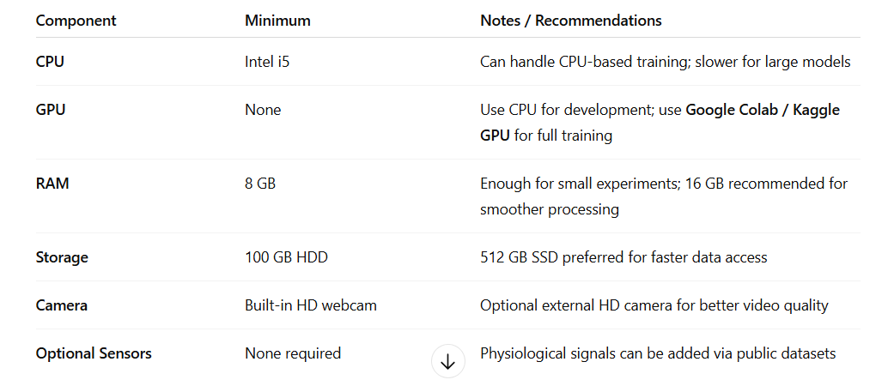
Hardware Requirements
Microphone Array
Physiological Sensors
GPU-Enabled Computing Unit
Deep Learning Frameworks
Optional physiological sensors like heart rate monitors and skin conductance devices can be used.
These sensors provide additional data for comprehensive analysis.
A high-performance computing unit with GPU capabilities is necessary.
This hardware supports efficient model training and inference tasks.
Software frameworks like TensorFlow and PyTorch are essential.
They enable the development and deployment of deep learning models.
19

Slide 20
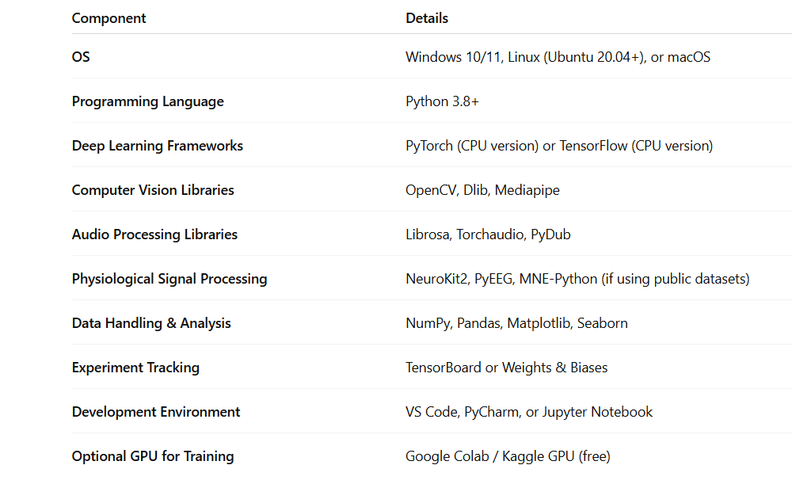
Software Requirements
Microphone Array
Physiological Sensors
GPU-Enabled Computing Unit
Deep Learning Frameworks
Optional physiological sensors like heart rate monitors and skin conductance devices can be used.
These sensors provide additional data for comprehensive analysis.
A high-performance computing unit with GPU capabilities is necessary.
This hardware supports efficient model training and inference tasks.
Software frameworks like TensorFlow and PyTorch are essential.
They enable the development and deployment of deep learning models.
19

Slide 21
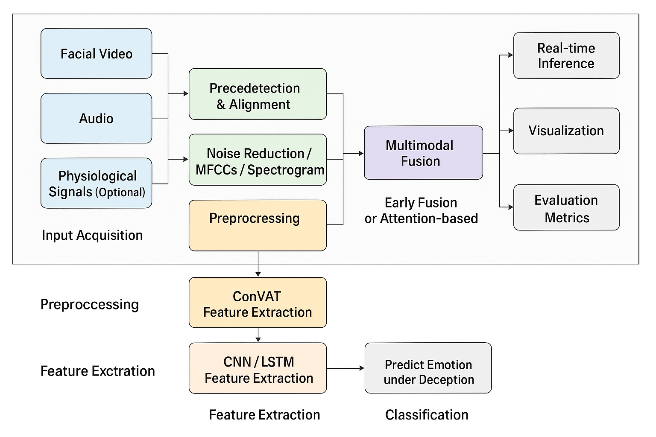
Proposed System Architecture
21

Slide 22
Timeline & References
10 September, 2025 to 19 November, 2025 (duration 2 months)

Slide 23
References
https://link.springer.com/article/10.1007/s00530-024-01302-2
Micro-Expression_Recognition_Using_Convolutional_Variational_Attention_Transformer_ConVAT_With_Multihead_Attention_Mechanism.pdf https://share.google/K1dCjMqxmzUiXogf8
A_Survey_on_the_Detection_and_Impacts_of_Deepfakes_in_Visual_Audio_and_Textual_Formats.pdf https://share.google/vulPbawCbJD3zQESX
https://link.springer.com/article/10.1007/s44196-024-00406-x?fromPaywallRec=true
https://link.springer.com/article/10.1007/s44196-024-00406-x?fromPaywallRec=true

